Slide 1
Deceleration of human rights
By Julian Lam

Slide 2
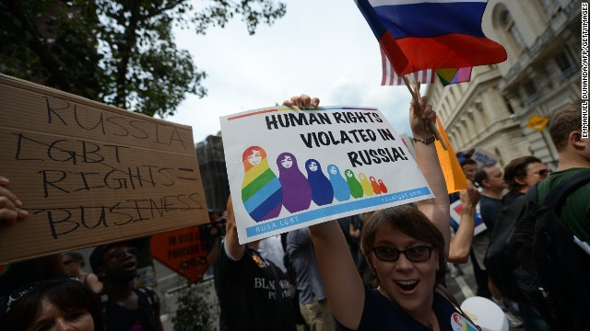
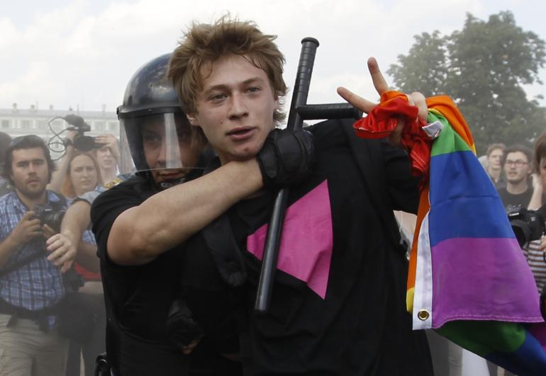
Article 1. All human beings are born free and equal in dignity and rights. They are endowed with reason and conscience and should act towards one another in a spirit of brotherhood.

Slide 3
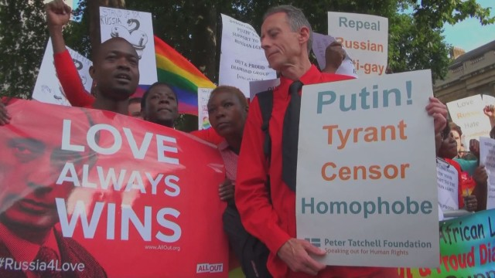
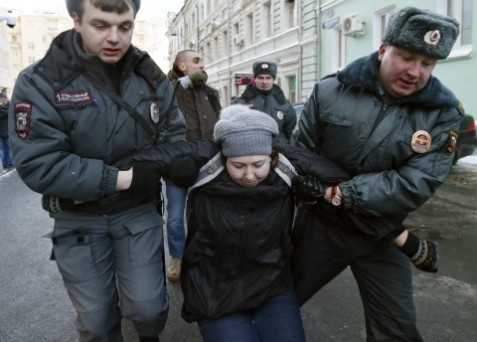
Article 2. Everyone is entitled to all the rights and freedoms set forth in this deceleration, without distinction of any kind, such as race, colour, sex, language, religion, political or other opinion, national or social origin, property, birth or other status. Furthermore, no distinction shall be made on basis of political, jurisdictional or international status od the country or territory to which a person belongs, whether it be independent, trust, non-self governing or under any other limitation of sovereignty.

Slide 4
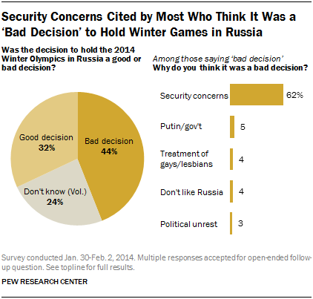
Article 3. Everyone has the right to life, liberty and security of person.

Slide 5
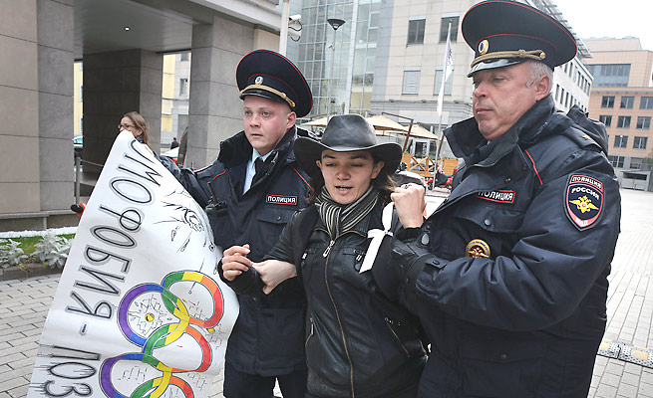
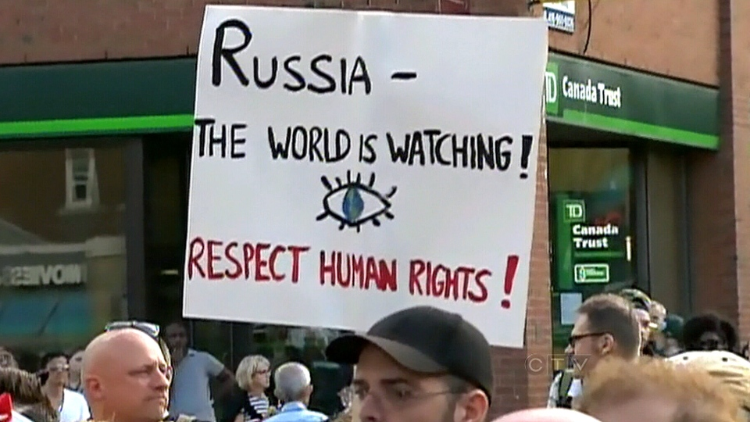
Article 6. Everyone has the right to recognition everywhere as a person before the law.

Slide 6
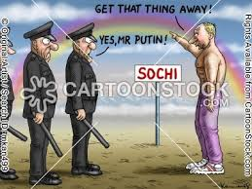
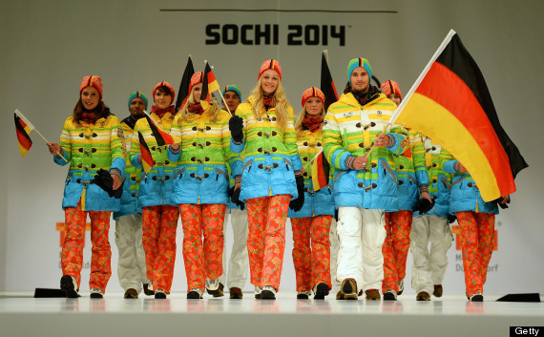
Article 19. Everyone has the right to freedom of opinion and expression; this right includes the freedom to hold opinions without interference and to seek, receive and impart information and ideas through any media and regardless of frontiers.

